Slide 1
The Geographer’s guide to Story maps
GIS Day
November 18, 2020
Hosted by:
College of Agriculture, Community, and the Science
Kentucky State University
Jill Brown
Assistant Professor,
Geography & Environmental Studies
Department of Earth, Environmental,
and Atmospheric Sciences
Western Kentucky University

Slide 2
What is a story map?
A story map is an interactive map that is combined with multimedia content such as text, images, charts, and graphs. - Esri
View the story map here

Slide 3
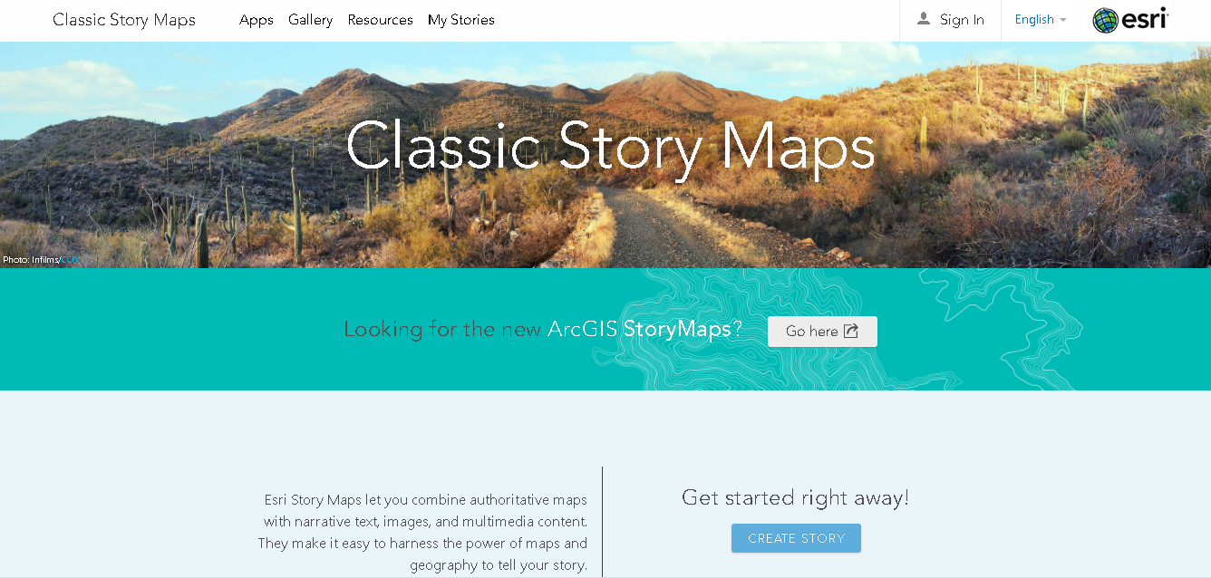
Where to find Story maps
For classic story maps click here
For the new story maps click here
This PowerPoint will refer to classic story maps

Slide 4
VIEWING AND FINDING A STORY MAP
To find an existing story map, click on the gallery tab at the top of classic story maps
Type in the search bar to find specific topics

Slide 5
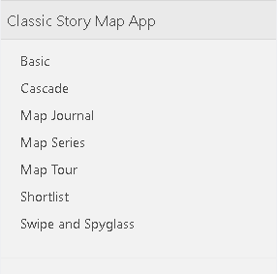
Browsing story maps:
Story maps can be browsed by type…
The KGA produces Kentucky in the News,
which is a GIS map of activities in Kentucky.

Slide 6
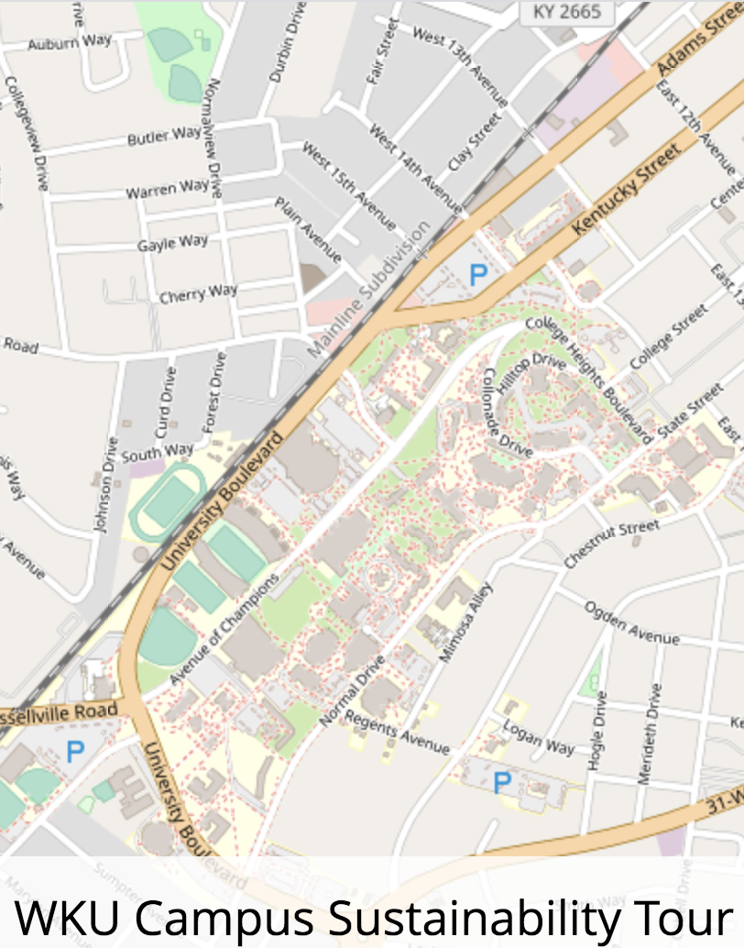
Browsing Story Maps Story maps can be browsed by:

Slide 7
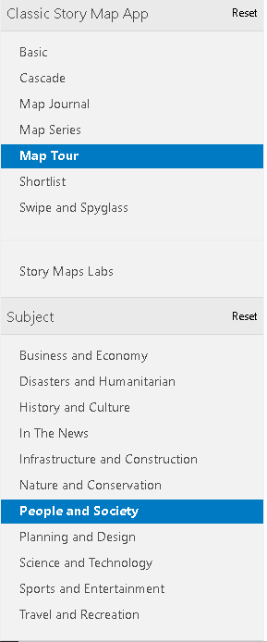
Browsing STORY MAPS
Multiple filters can also be selected at the same time to provide the most relevant results

Slide 8
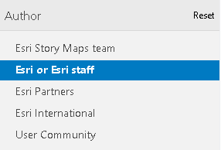
Search Example:
Searching for a story map relating to demographics
Author of story map is ESRI or ESRI staff

Slide 9
search results:

Slide 10
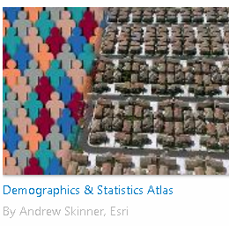
Sample story map:
One of the results of the previous search is called Demographics and Statistics Atlas. This story map focuses on how population has grown in the U.S. using data directly from ESRI and the US Census Bureau 2010 census
Click here to view the story map

Slide 11
Navigating a story map:
Tabs
The navigation of a story map depends on the layout of the map
These layouts are discussed later in the PowerPoint
The sample story map from the previous slide is a map series, meaning that tabs are at the top of the map while content is displayed to the left of the current map
To display the information in each of the tabs, click on the arrows beside each headline
Map
Content

Slide 12
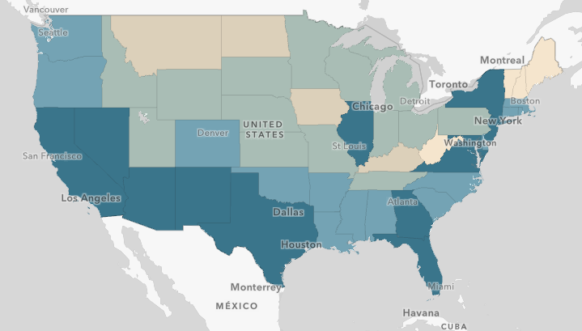
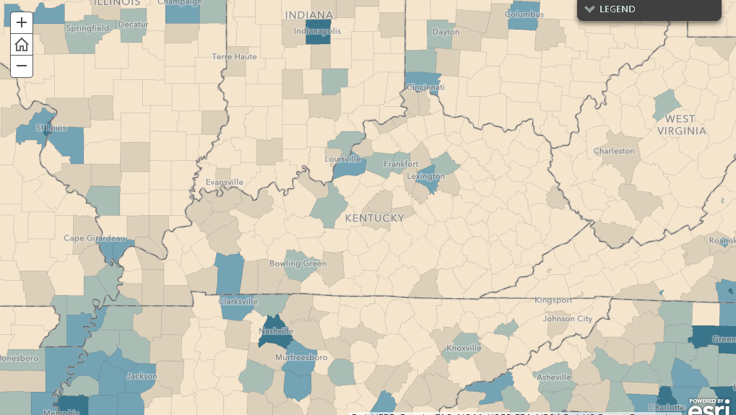
Navigating a story map:
The scale at which the maps are viewed can be changed by clicking the or symbols on the map
The same map viewed at different scales

Slide 13
View legend
Story maps often have an option to view the legend of the map if it is not currently displayed
To display legend, if not already displayed, click the down arrow by the box that says legend
To hide the legend, select the up arrow by legend

Slide 14
Interacting with the story map
The maps within the story maps are often interactive
In the demographics story map, each county can be selected to view individual information about the county
The individual information for diversity also includes an interactive pie chart that shows the prevalent ethnicities in the selected county

Slide 15
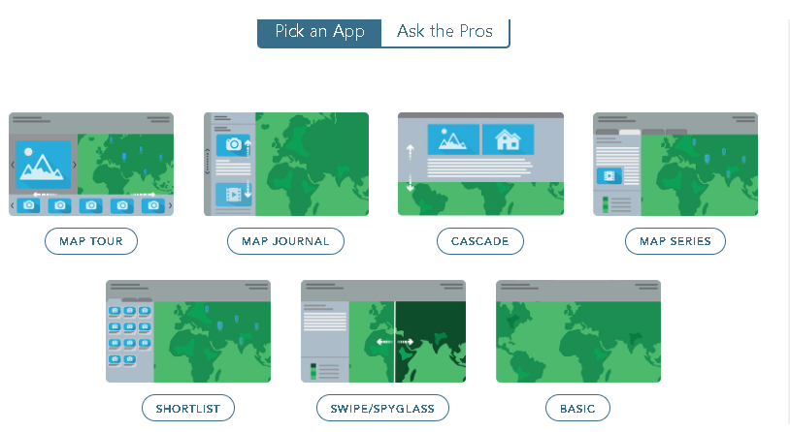
Story map Layout ESRI offers 7 different layouts

Slide 16
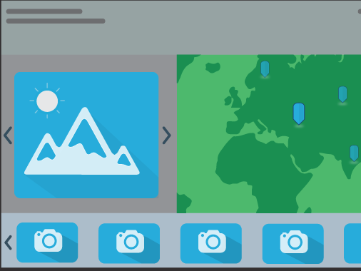
Layout: MAP TOUR
Useful for guiding people through a sequence of different places

Slide 17
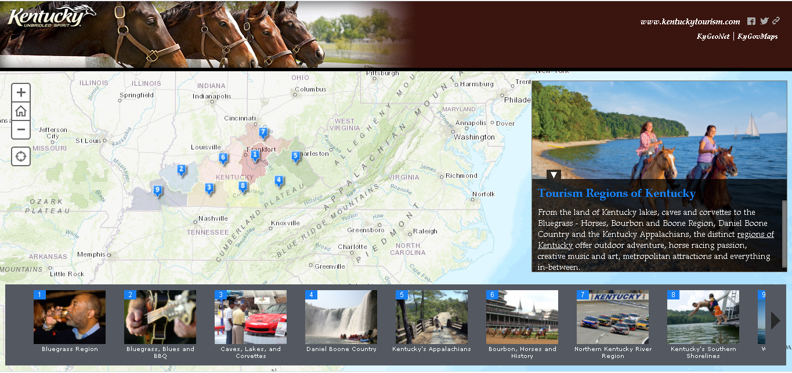
Map Tour Example
Map tour used to show tourism areas across Kentucky
Each location represented by a point on a single map
Images and a description are provided for each area
View the story map here

Slide 18
LAYOUT: MAP JOURNAL
Has a scrolling side panel for text and other multimedia

Slide 19
Map journal exAmple
Several maps to explore the connectivity of sidewalks across Kenton County, Kentucky
Content is located to left of map
View the story map here

Slide 20
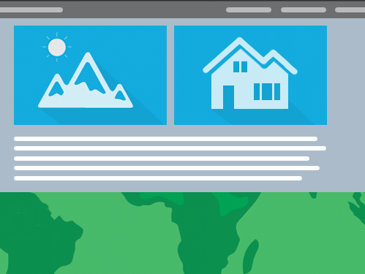
lAyout: cascade
Immersive full-page scroll

Slide 21
Cascade Example
Click here to view this story map
By scrolling, the entire story map moves

Slide 22
LAYOUT: MAP SERIES
Good when having multiple maps with a similar topic
More common
The previous demographic story map is a map series.

Slide 23
LAYOUT: SHORT LIST
Organizes places into tabs

Slide 24
Shortlist Example
Each great place in America in tabs to left
Map with pinpoints of each feature to right
View story map

Slide 25
LAYOUT: SWIPE/spyglass
Useful for comparing two maps using a slider

Slide 26
Swipe Example
This story map uses a spyglass to show before and after aerial imagery of Kentucky
Click here to further explore this story map

Slide 27
LAYOUT: BASIC
Minimalistic
Best for one map

Slide 28
Basic Example
Description of maple syrup festivals at the top
Map at bottom
Symbols can be selected to show more information about a point
View this story map here

Slide 29
Resources for creating your own Story map
https://storymaps-classic.arcgis.com/en/how-to/
A basic overview of the process of making a story map
http://www.nancylangston.net/creating-story-maps.html
Step by step process and links of adding images and sections to a story map as well as creating a map for your story map
https://learn.arcgis.com/en/projects/get-started-with-story-maps/
Provides specific examples and steps for creating a story map tour, cascade, and map journal
https://storymaps-classic.arcgis.com/en/resources/
Storytelling with maps – the fundamentals

Slide 30
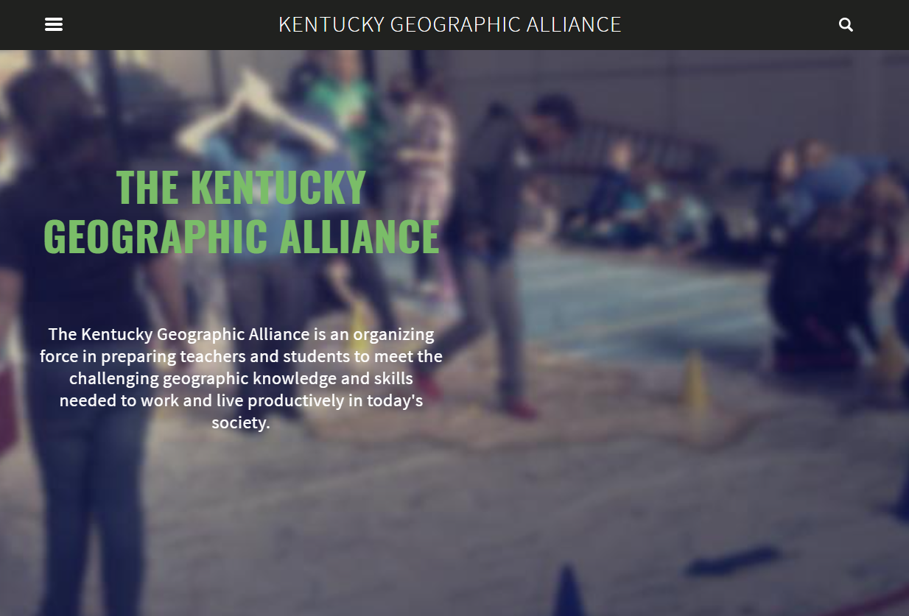
Visit our website for more geography and GIS teacher resources.

Slide 31
ArcGIS Online Competition for US HS+MS Students
Esri Competition – Spring 2021
National competition explained in a story map: click here
For more information about the Kentucky competition contact the Kentucky Geographic Alliance (KGA): kga@wku.edu

Slide 32
Story Map Links
Kentucky’s Climate During the Civil War, by Glen Conner https://wkugis.maps.arcgis.com/apps/MapSeries/index.html?appid=f3fac24176d1472281c6a40a655c1fca
Recycling Plastics in Kentucky https://kga.maps.arcgis.com/apps/MapJournal/index.html?appid=56c4607d25b44da0af6ecaf1c744d1a5
ArcGIS Online Competition for US HS & MS Students https://www.arcgis.com/apps/MapJournal/index.html?appid=2e3e40eea7dd459cb82604d76f40e3cf

