Slide 1
Urban Settlement Patterns
Jill Brown
AP Human Geography Workshop
Louisville, KY

Slide 2
Urban Settlement Patterns Overview
Site & Situation
Common Settlement Patterns
Settlement Models
Modern Urban Areas
Contemporary Influences on Urban Development
Primate City Activity

Slide 3
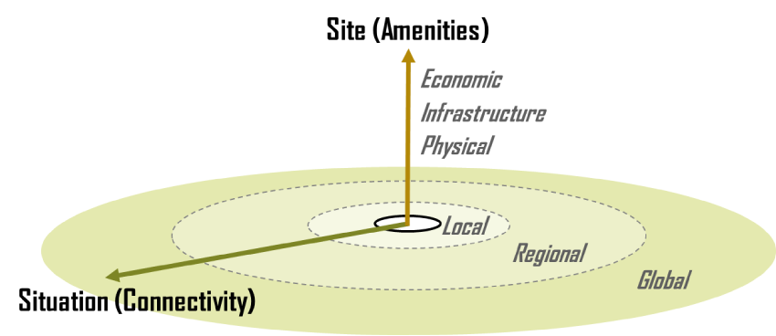
Site & Situation
Source: The Geography of Transport Systems. 2016. https://people.hofstra.edu/geotrans/eng/ch1en/conc1en/sitesituation.html

Slide 4
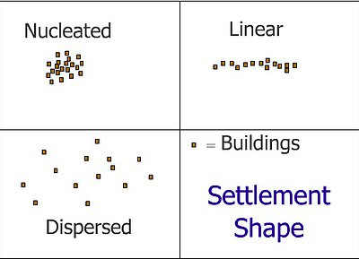
Common Settlement Patterns
Source: Settlement Diagrams. 3D Geography. 2016 http://www.3dgeography.co.uk/settlement-diagrams

Slide 5
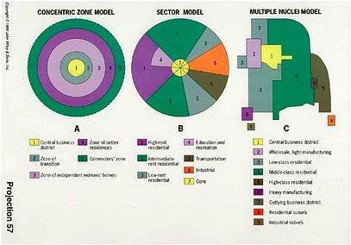
Settlement Models
Source: Settlement Diagrams. 3D Geography. http://www.3dgeography.co.uk/settlement-diagrams

Slide 6
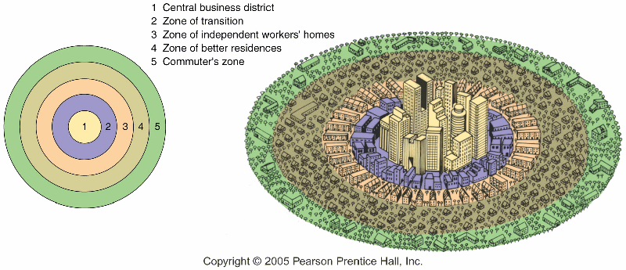
Concentric Zone Model
Concentric Zone Model. Science People. 2016
http://sciencepole.com/concentric-zone-model/

Slide 7
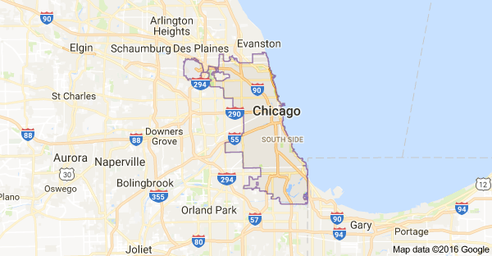
Chicago Concentric Zone City
Source: Google Maps.

Slide 8
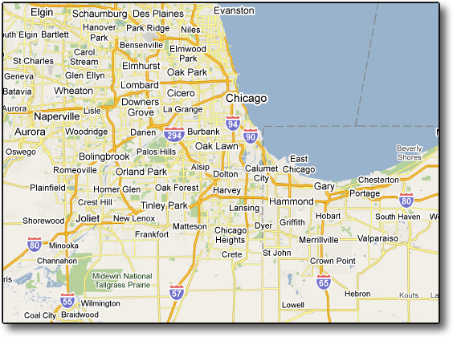
Chicago Suburbs Concentric Zone Model
Source: Google Maps

Slide 9
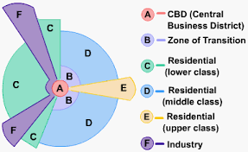
Sector Model

Slide 10
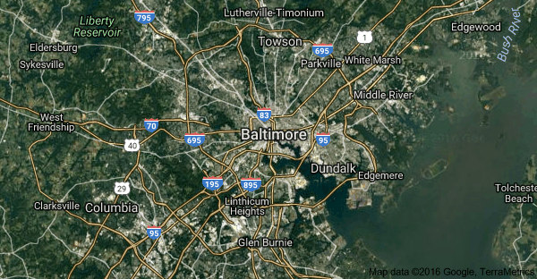
Baltimore Sector Model City
Source: Google Maps

Slide 11
Chicago Graphic: Shows the growth of the city and median incomes over the last 40 years
http://cdn.citylab.com/media/img/citylab/legacy/2014/04/02/incseggif.gif

Slide 12
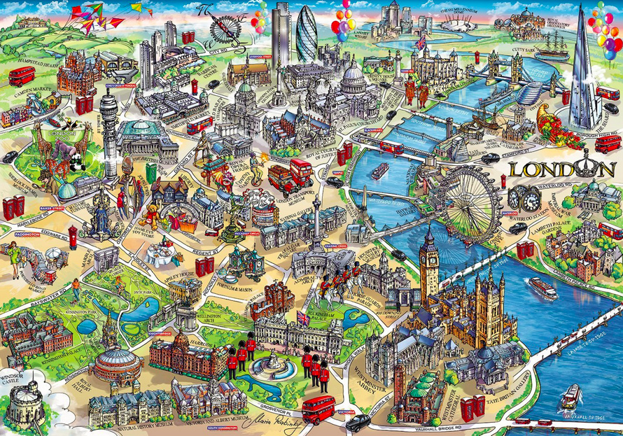
London Sector Model City
Source: Mapping London. http://mappinglondon.co.uk/

Slide 13
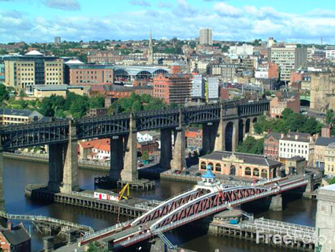
Newcastle, UK Sector Model City
Source: Phone Book of Newcastle Upon Tyne. http://phonebookoftheworld.com/newcastleupontyne/

Slide 14
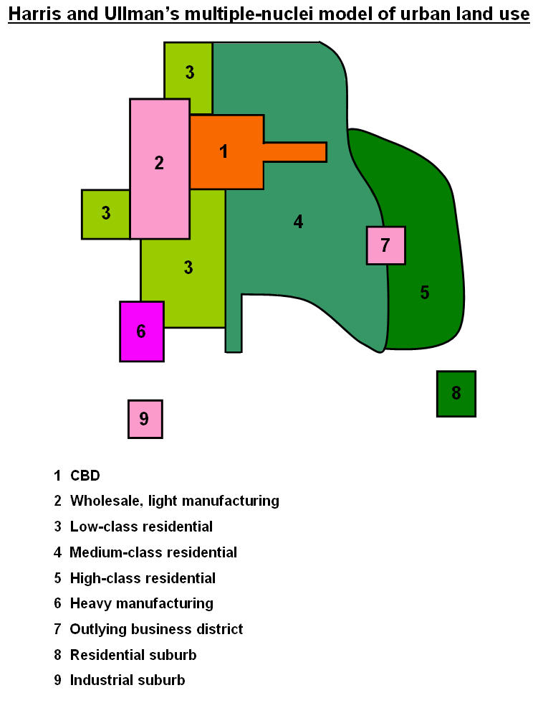
Multiple Nuclei Model
Source: The Internal Structure of Cities. http://cronodon.com/PlanetTech/Cities_Structure.html

Slide 15
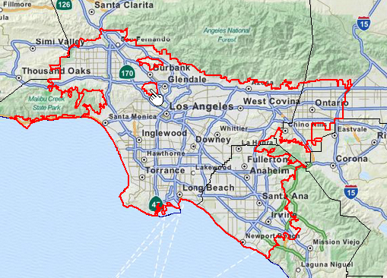
Los Angeles Multiple Nuclei City
Urban Structure Models. Martin’s AP Human Geography. 2012.
http://www.martinsaphug.com/learn/units/urbanization/urban-structure-models/

Slide 16
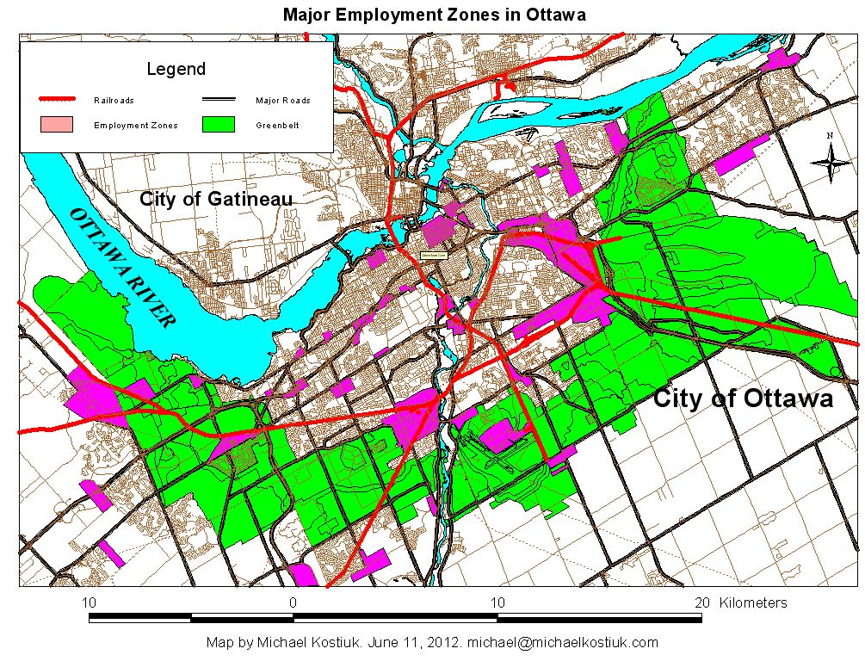
Ottawa Multiple Nuclei City
Source: The Greenbelt, Satellite Cities and Transportation in Ottawa. 21 Jul 2014. http://www.michaelkostiuk.com/greenbelt/index.html

Slide 17
Modern Urban Areas
Made up of a combination of settlement patterns
Aspects of the three city models
Source: All About Atlanta. 2016. http://www.movoto.com/guide/atlanta-ga/

Slide 18
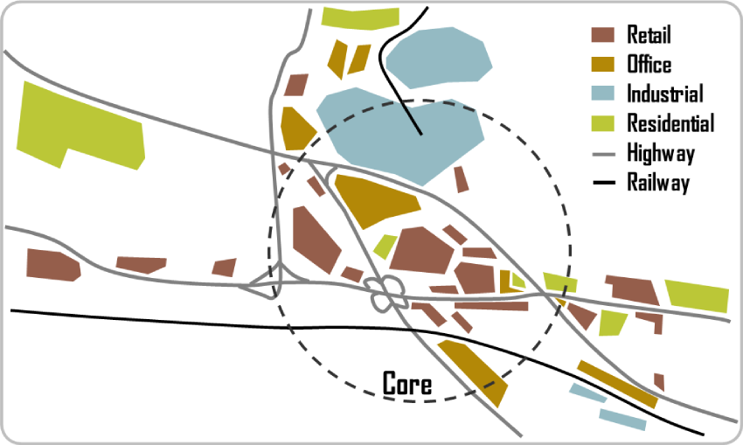
Contemporary Influences on Urban Development
Source: The Geography of Transport Systems. 2016. https://people.hofstra.edu/geotrans/eng/ch6en/conc6en/subhighway.html

Slide 19
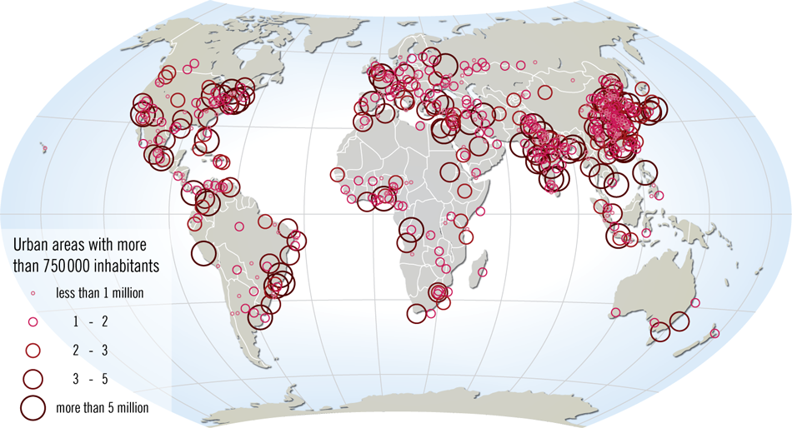
Primate City Activity
Source: Rank Size versus Primate City. APHG Class Wiki. http://lewishistoricalsociety.com/wiki2011/tiki-read_article.php?articleId=106

Slide 20
Country | Largest City & Population | Second Largest City & Population

Slide 21
Questions
Thank you for coming!
Source: Free Vectors. 2015. http://all-free-download.com/free-vector/city-silhouette-vector-free.html

